Slide 1
Taxpayers Data Analytics
Uncovering Revenue Trends & Taxpayer Behavior using SQL & Power BI
Presented by: Ankita Shirish Manchalwar
Tools Used: MySQL | Power BI | Data Modeling

Slide 2
PROJECT CONTEXT
Problem Statement & Business Objectives
The Business Problem
•Tax departments handle millions of filings each year, making it difficult to see overall revenue trends hidden in raw data.
• Hard to track deduction impact on revenue without central reporting.
•Decision-makers need clear data on taxpayer habits, age groups, and top-earning regions.
Core Objectives
• Segment Taxpayers by Income Groups: Analyze the number of filers with the actual tax collected from each income group.
• Evaluate Regional Contributions: Identify high-performing states and revenue clusters across India.
• Old vs. New Tax Regimes: Understand adoption behavior and its direct effect on total deductions claimed.
• Build an Executive Dashboard: Deliver an interactive Power BI dashboard for leadership decision-making.

Slide 3
ARCHITECTURE & PIPELINE
Tools & Analytical Methodology
1. Data Sourcing & Schema
• Dataset: 1,000 synthetic records with 12 structured attributes.
• Attributes: Taxpayer ID, Gender, State, Age Group, Filing Type, Slabs, Tax Paid.
• Schema: Configured in MySQL Workbench with proper data types.
2. SQL Analytical Layer
• Data Validation: Verified 1,000 complete rows without nulls.
• Conditional Logic: Utilized WHEN clause for income bracket categorization.
• Aggregations: GROUP BY to analyze state and demographic trends.
3. Power BI Dashboard Layer
• Importing Data : Imported verified dataset into Power BI Desktop.
• DAX Measures: Built custom measures for Total Revenue, Total Filers, Total Deductions and Avg Tax paid.
• User Interactivity: Configured Slicers (Year, Gender) and cross-filtering visuals.

Slide 4
DATABASE QUERYING
Key SQL Queries & Logic
Income Slab Segmentation (CASE WHEN)
Business Question: Which income group contributes the most tax revenue?
SELECT
CASE
WHEN Gross_Income < 500000
THEN 'Low Income (< 5L)'
WHEN Gross_Income BETWEEN 500000
AND 1500000 THEN 'Middle Income (5L - 15L)'
ELSE 'High Income (> 15L)'
END AS Income_Slab,
COUNT(Taxpayer_ID) AS Total_Filers,
SUM(Tax_Paid) AS Total_Revenue,
ROUND(AVG(Tax_Paid), 2) AS Avg_Tax_Paid
FROM taxpayers
GROUP BY Income_Slab
ORDER BY Total_Revenue DESC;
Regime Comparison & Top States
Business Question: Compare Old vs. New Regimes & identify top tax states.
-- Query 4: Old vs New Regime Analysis
SELECT
Tax_Regime,
COUNT(Taxpayer_ID) AS Total_Filers,
SUM(Total_Deductions) AS Total_Deductions_Claimed,
SUM(Tax_Paid) AS Total_Tax_Collected
FROM taxpayers
GROUP BY Tax_Regime;
-- Query 3: Top 5 States by Tax Collection
SELECT
State,
COUNT(Taxpayer_ID) AS Total_Filers,
SUM(Tax_Paid) AS Total_Tax_Revenue
FROM taxpayers
GROUP BY State
ORDER BY Total_Tax_Revenue DESC
LIMIT 5;

Slide 5
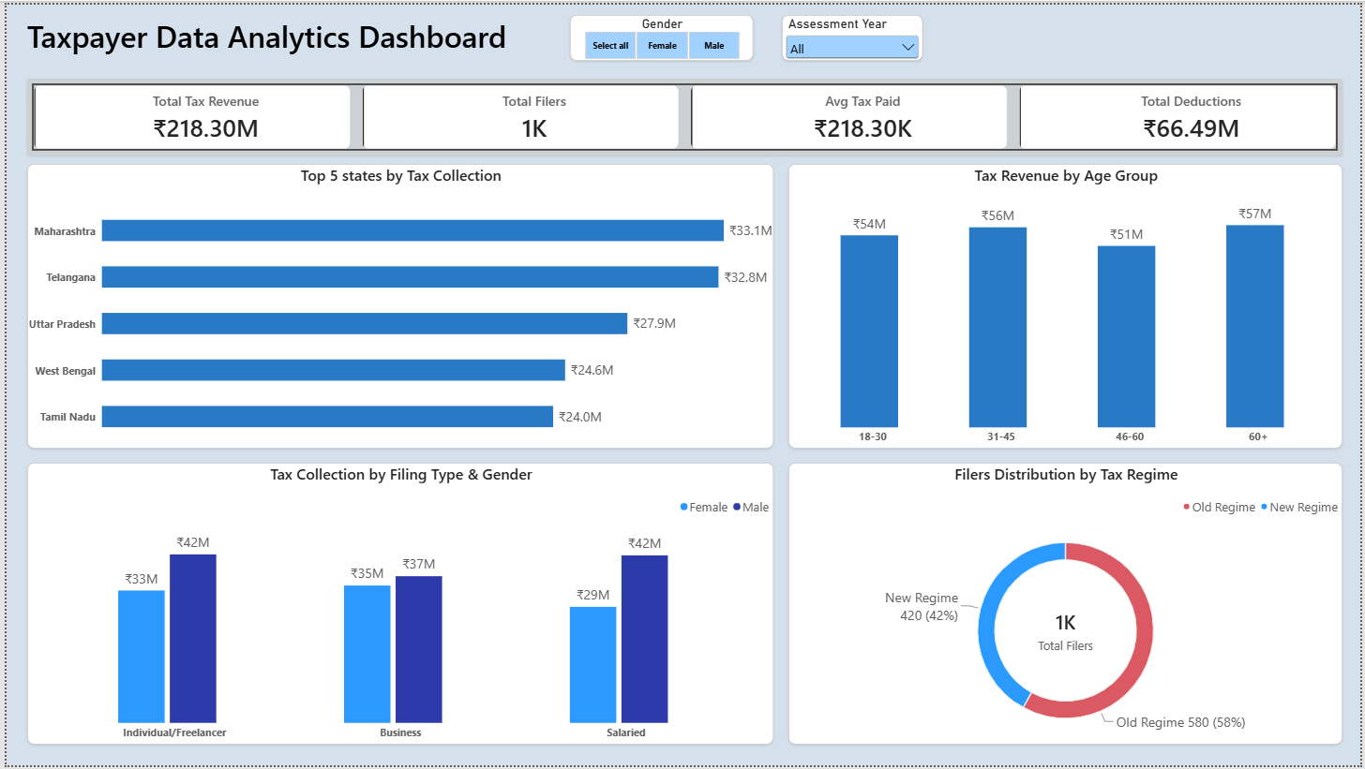
DATA VISUALIZATION
Executive Power BI Dashboard
TOTAL TAX REVENUE
₹ 21.83 Cr
TOTAL FILERS
1,000
AVG TAX PAID
₹ 218,302
TOTAL DEDUCTIONS
₹ 6.65 Cr
[Power BI Dashboard Screenshot]

Slide 6
ANALYTICAL TAKEAWAYS
Key Business Insights & Findings
Geographic Concentration
States like Maharashtra (₹3.31 Cr), Telangana (₹3.28 Cr), and Uttar Pradesh (₹2.79 Cr) represent the top revenue contributors, driven by major urban and industrial centers.
Tax Regime Adoption & Deductions
Filers opting for the Old Regime account for 100% of deduction claims (~₹6.65 Cr). The New Regime attracts filers prioritizing lower base tax rates without claiming Section 80C/80D benefits.
Income Brackets & Revenue Impact
High-income earners (> ₹15L) contribute the largest share of total tax revenue despite representing a smaller percentage of overall filing volume.
Demographic Filing Trends
Working professionals in the 31-45 and 46-60 age groups form the core tax foundation across both salaried and business categories.

Slide 7
NEXT ITERATIONS
Future Scope & Project Enhancements
Automated Data Workflow in Python
Build end-to-end automated scripts using Pandas & NumPy to clean, validate, and transform large raw CSV filings before importing the data.
Exploratory Data Analysis (EDA)
Utilize Python libraries (Matplotlib & Seaborn) to uncover data trends, outliers, and relationships between income and deductions.
Automated Executive Reporting
Develop scheduled Python scripts to auto-generate and export periodic tax summary reports in Excel or PDF formats.
Interactive What-If Simulation in Power BI
Introduce Power BI What-If parameter sliders to simulate the revenue impact of proposed tax rate changes.

Slide 8
SUMMARY & Q&A
Business Recommendations & Conclusion
Strategic Recommendations
• Targeted Taxpayer Education: Conduct filing literacy programs in developing regions and younger demographics (18-30) to expand the tax base.
• Regime Transition Monitoring: Continue tracking shifts toward the New Regime to ensure revenue stability while evaluating taxpayer deduction preferences.
• Resource Optimization: Focus tax audits and support services on top-contributing metro cities and high-income brackets.
Thank You!
Successfully delivered an end-to-end data analytics workflow:
• MySQL Schema & Analysis
• Power BI Executive Dashboard
• Strategic Business Insights
Open for Questions ….

